Slide 1

R in Action:
A Dive into RNASeq Data
Heshmat Borhani
BSc, MSc, PhD, FHEA, FIBMS
Heshmat.Borhani@nottingham.ac.uk
Office hours; Mondays 12:00-13:00
Life Science Building, B61

Slide 2
Join the Vevox session
Go to vevox.app
Enter the session ID: 196-126-403
Or scan the QR code

Slide 3

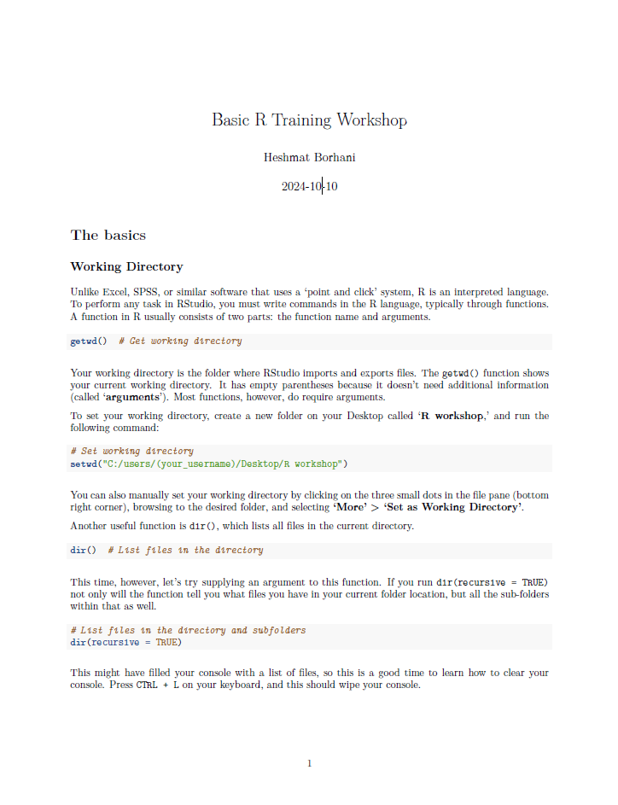
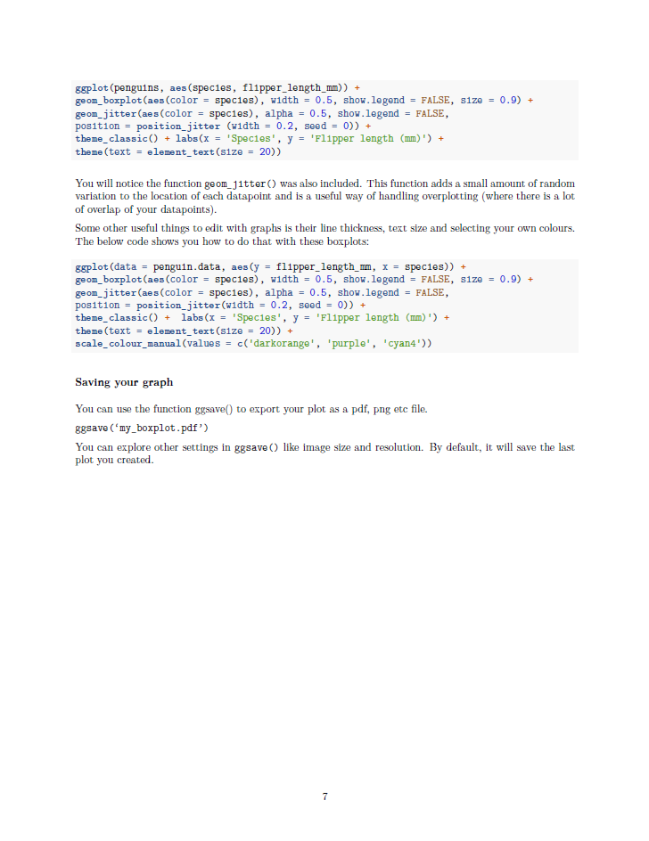
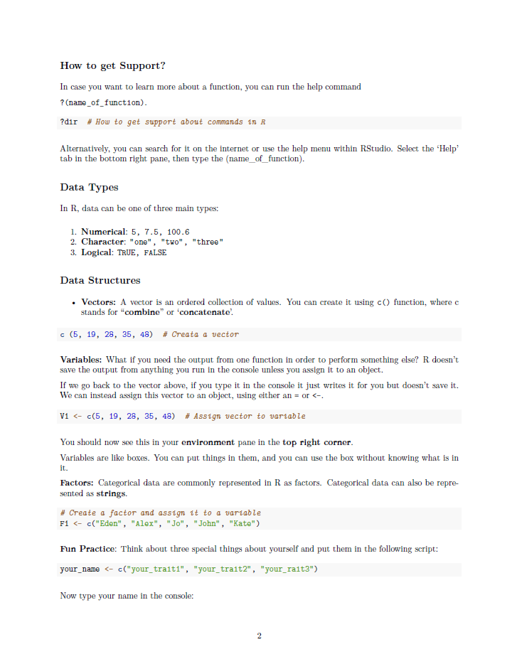
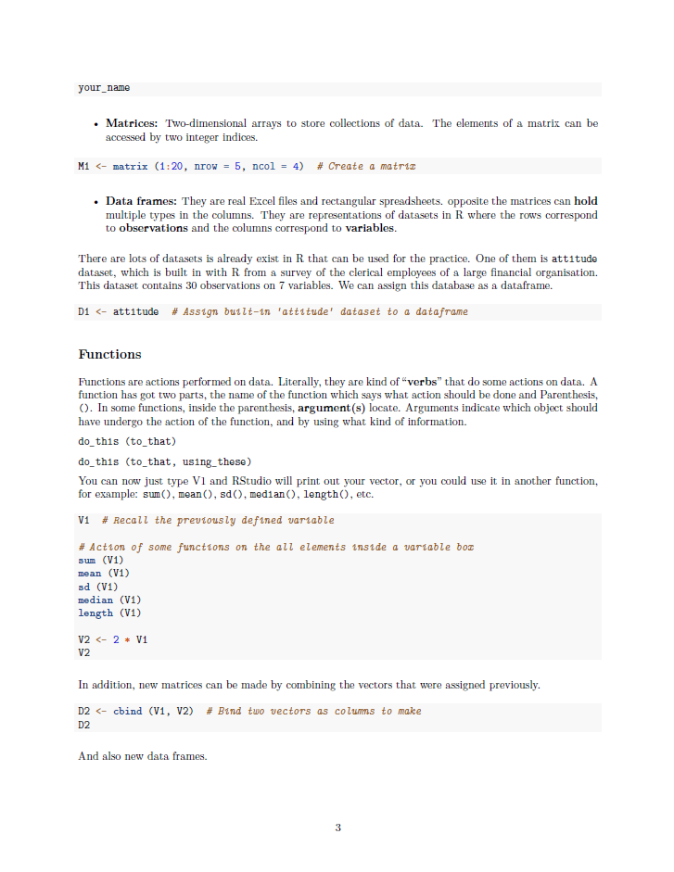
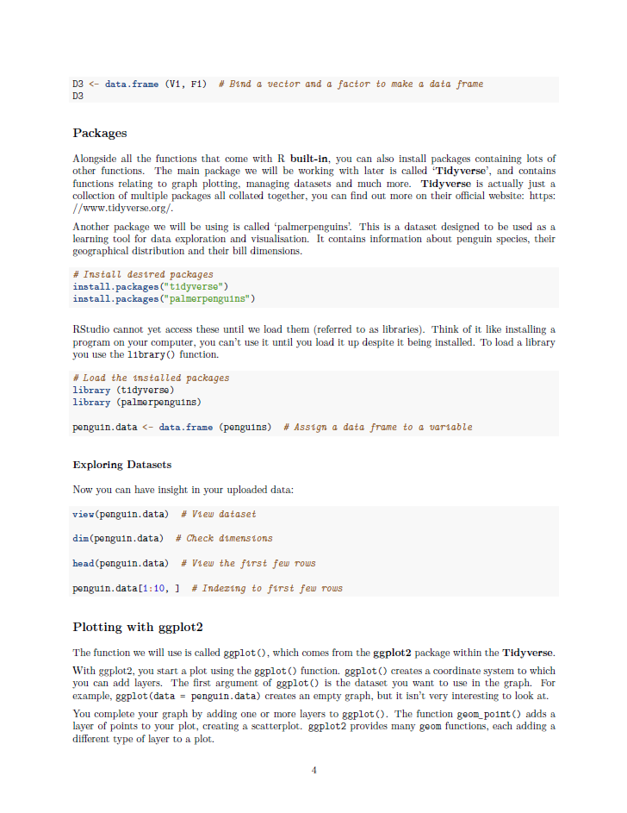
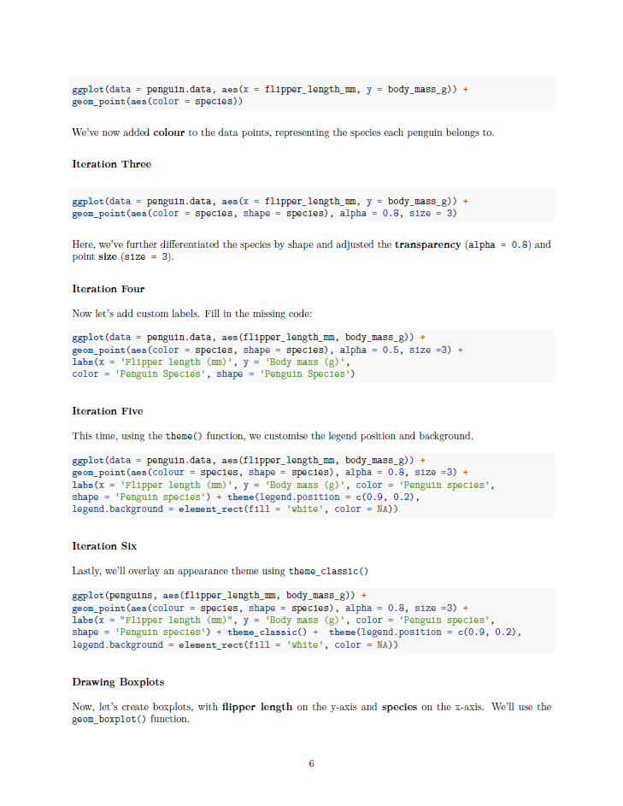
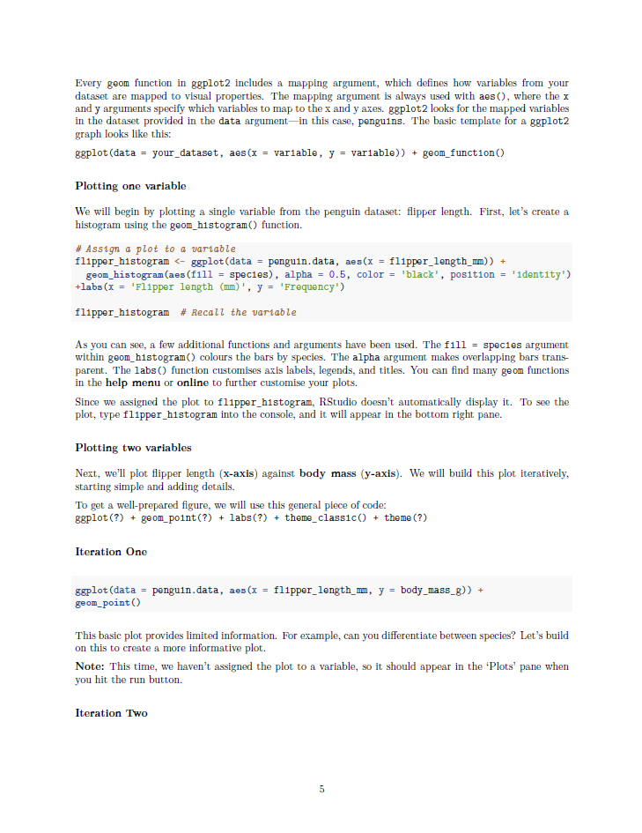
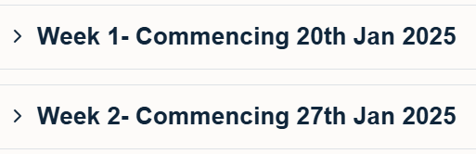
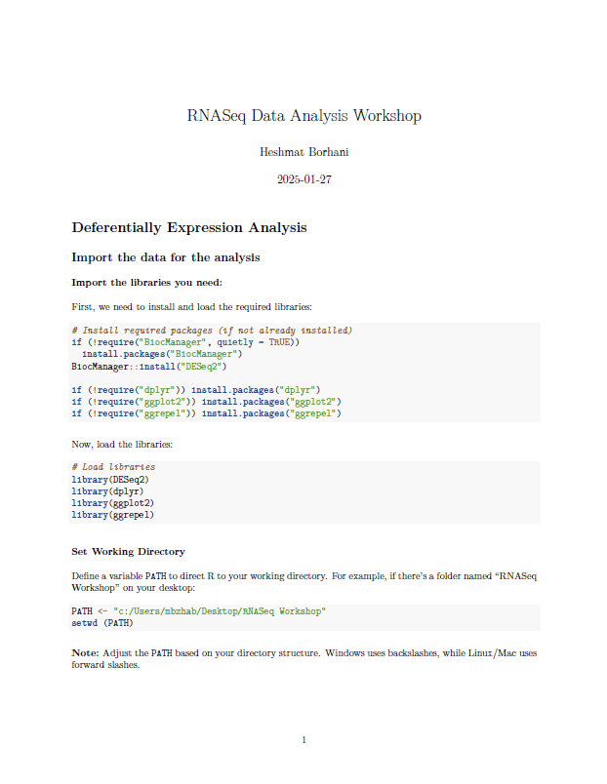
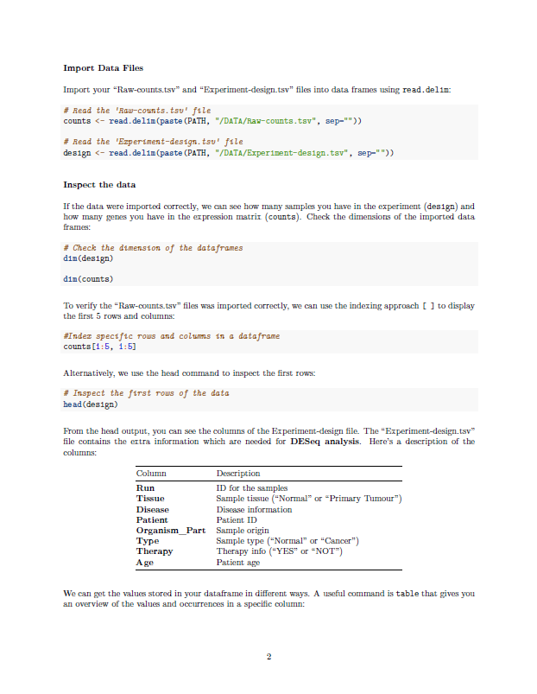
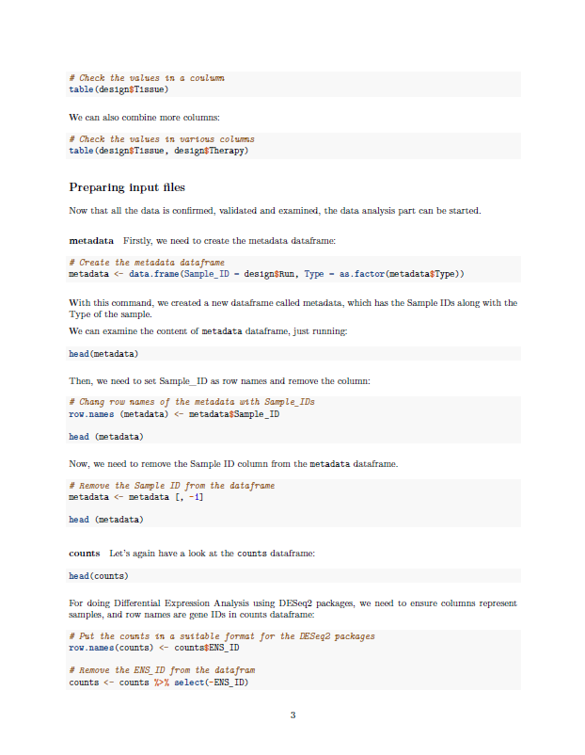
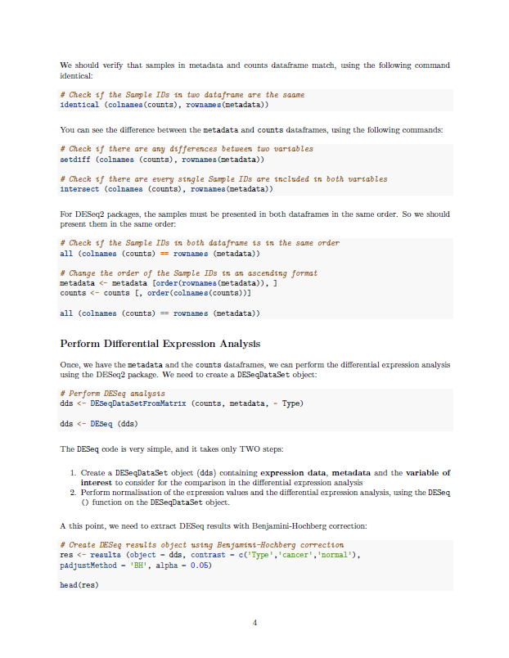
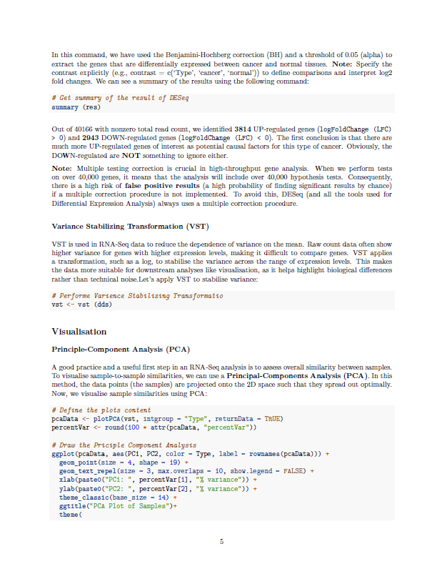
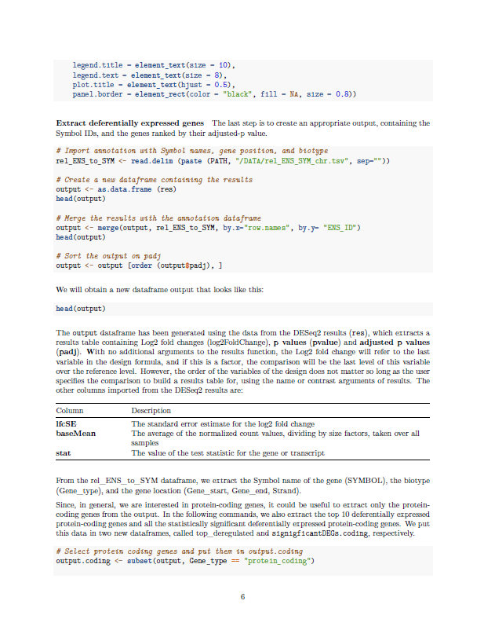
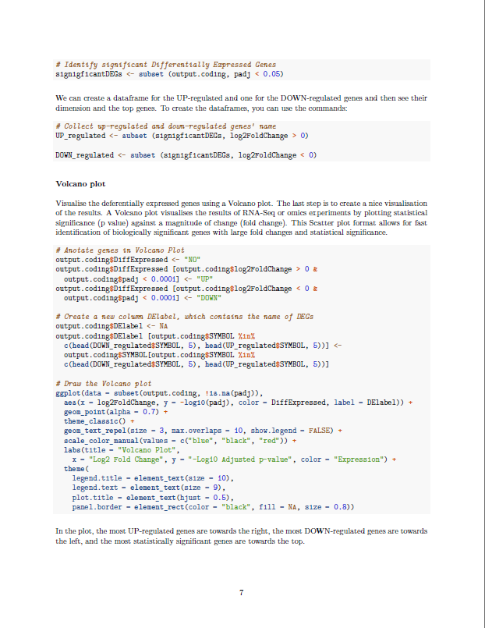
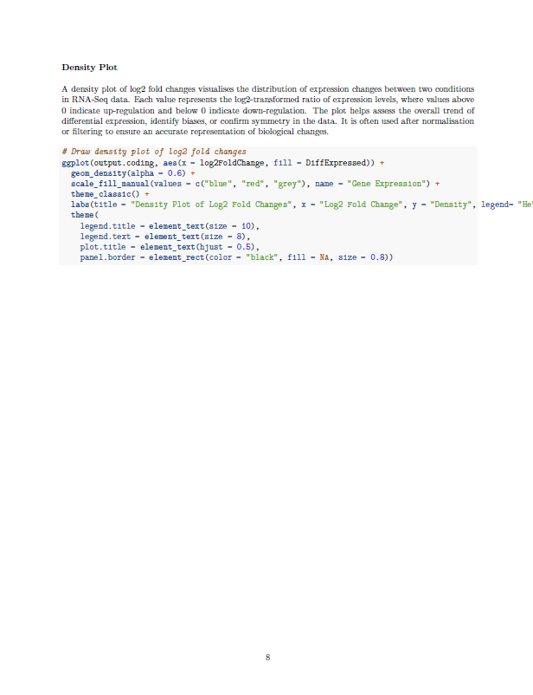
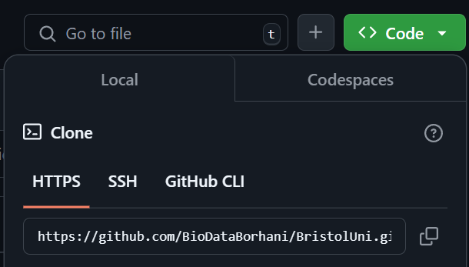
Timeline
Lecture on the introduction of basic R, data types, data structure, datasets, functions
MON
TUE
WED
THR
FRI
SAT
SUN
1
2
3
4
5
Lecture on how R can be used in transcriptomics
6
7
8
9
10
11
12
Workshop on basic R, running basic commands
13
14
15
16
17
18
19
20
21
22
23
24
25
26
github.com/BioDataBorhani/BristolUni
27
28
29
30
31
Workshop on RNASeq data, manipulating and visualisation
R in Action: A Dive into RNASeq Data | Dr Heshmat Borhani | Jan 2025

Slide 4
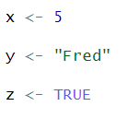

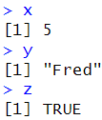

Core Data Types
Recap
Variables
Nominal
1, 20, 103.8, 31.1
Variables are names or labels that store or reference objects (values), including functions.
Character
"Fred", "T", "One", "20"
Variable
Logical
TRUE, FALSE
R in Action: A Dive into RNASeq Data | Dr Heshmat Borhani | Jan 2025

Slide 5
Core Data Structures
Recap
Factors
[1]
[2]
[3]
Vectors
One-dimensional arrays used to store collection data of the same mode
Elements
[,1]
[,2]
[,3]
[,4]
Two-dimensional arrays used to store collection data of the same mode
[1,]
Matrices
[2,]
Rows
[3,]
Columns
[,1,]
[,2,]
[,3,]
Multi-dimensional (more than two dimensions) matrix-like structure.
[, ,1]
[, ,2]
Arrays
[, ,3]
Rows
[, ,4]
[1, ,]
[2, ,]
Layers
Columns
R in Action: A Dive into RNASeq Data | Dr Heshmat Borhani | Jan 2025

Slide 6
Core Data Structures
Recap
Column Name1
Column Name2
Column Name3
Column Name4
Generalisation of matrices where different columns can store different mode data. Tabular structure like an Excel worksheet.
Row Name1
Data Frame
Row Name2
Row Name3
Rows
Row Name4
Columns
,
,
,
List
Ordered collection of objects, where the elements can be of different structure types.
,
R in Action: A Dive into RNASeq Data | Dr Heshmat Borhani | Jan 2025

Slide 7
Learning Objectives
The Learning Outcomes (LOs) for this Unit
A: Knowledge and Understanding:
To understand how to code in R, and the logic behind coding more generally.
To develop knowledge on the different data structures used in R and how these data can be manipulated
To acquire the concepts behind the use of libraries in R, data visualisation and presentation.
B: Intellectual Skills/Attributes:
To devise the best statistical design to analyse different biological data.
To design R scripts and critically assess their suitability to different analysis types.
To plan the best use of different resources (modules, libraries, etc.) to solve different statistical analyses.
C: Other Skills /Attributes (Practical/Professional/Transferable):
To acquire proficiency coding in R, and interpreting the output of statistic tests
To demonstrate competence with R to write scripts and data visualisation techniques.
To gain strengths in computer coding, code sharing, and open-source programming
1
Understand fundamental concepts about RNASeq data, and why it is important
2
Be able to load, manipulate, and visualise RNASeq data to differentiate between two groups
3
Investigate how gene expression data can be analysed and interpreted
R in Action: A Dive into RNASeq Data | Dr Heshmat Borhani | Jan 2025

Slide 8
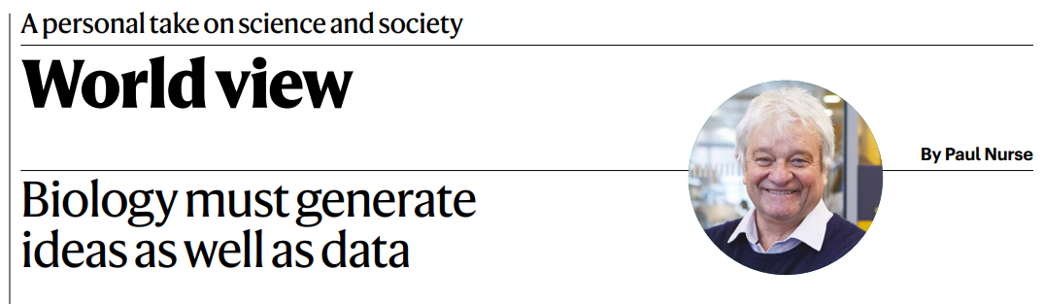



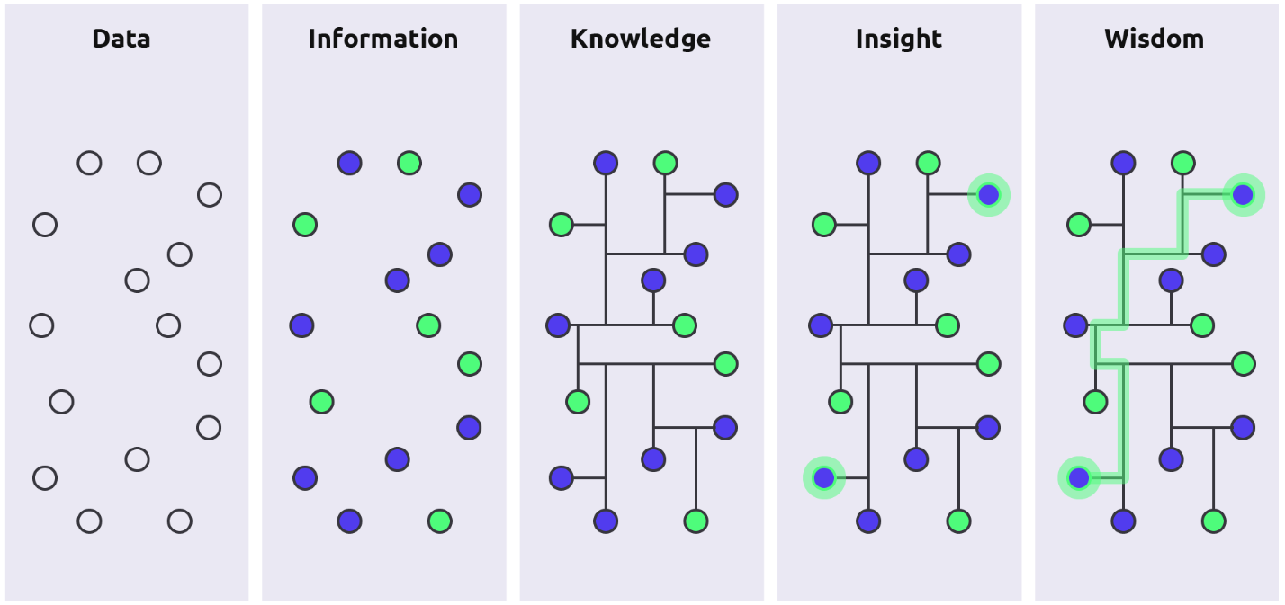


Data to Wisdom
WISDOM
https://www.nature.com/articles/d41586-021-02480-z
INSIGHT
“We are drowning in a sea of data
and starving for knowledge”
KNOWLEDGE
INFORMATION
DATA
https://www.netpresenter.com/
R in Action: A Dive into RNASeq Data | Dr Heshmat Borhani | Jan 2025

Slide 9
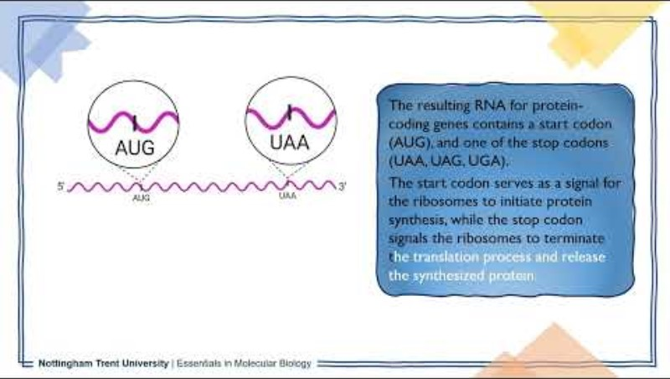
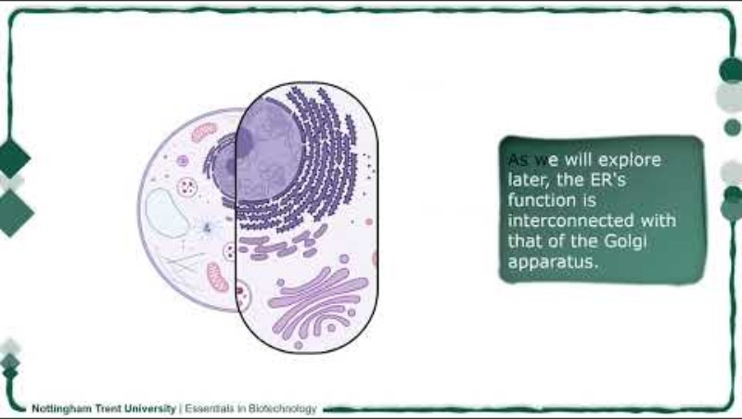
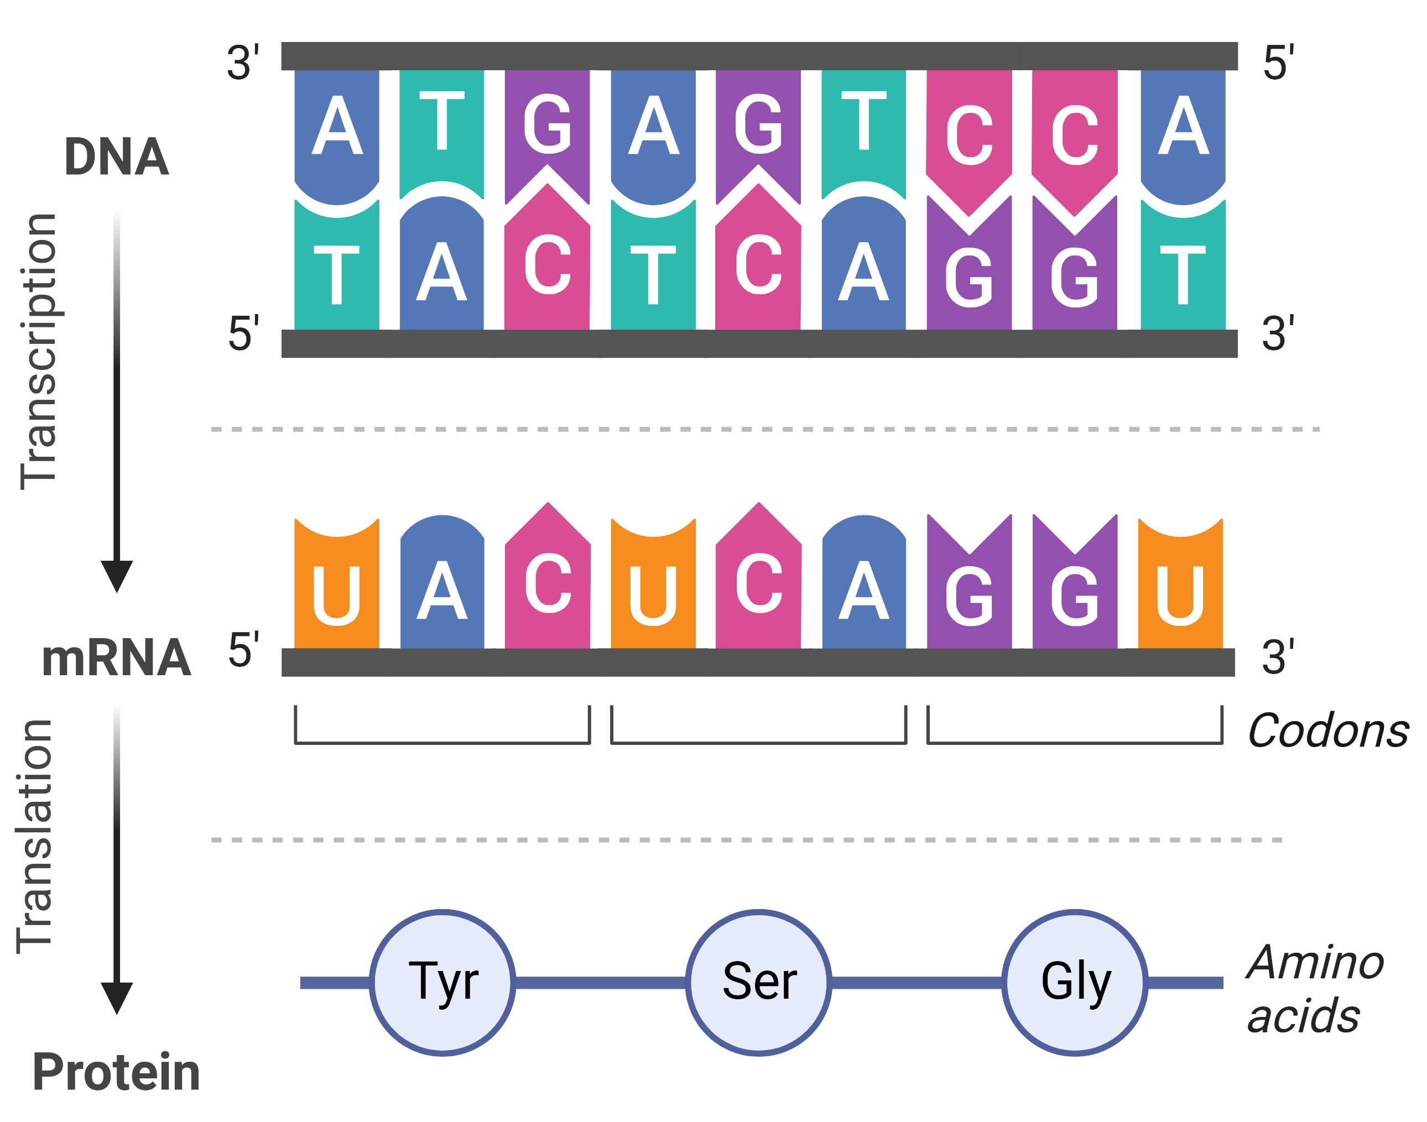
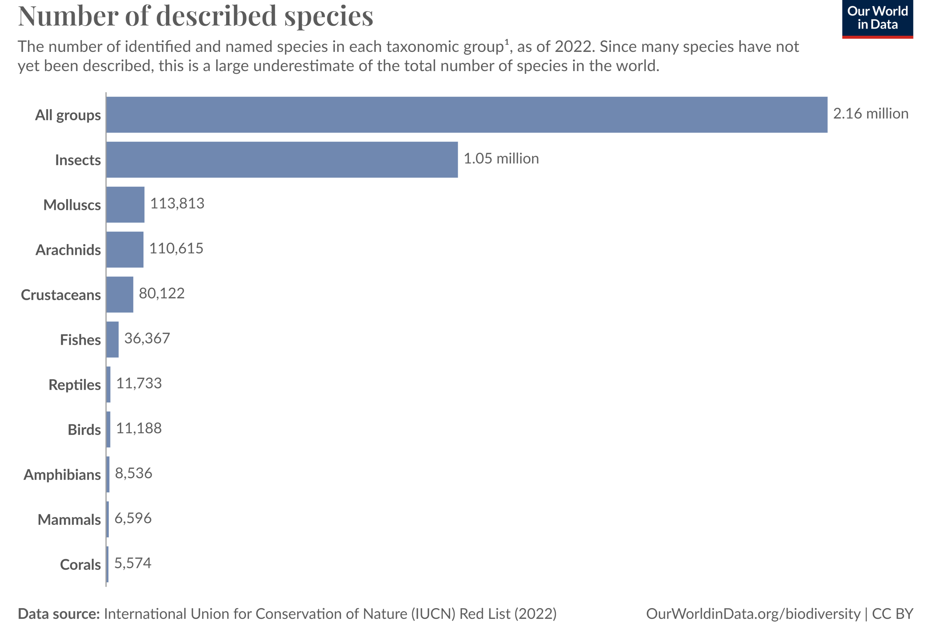
Unity in the Diversity
Central Dogma
Phenotypes
https://ourworldindata.org/how-many-species-are-there
R in Action: A Dive into RNASeq Data | Dr Heshmat Borhani | Jan 2025

Slide 10

Information Flow
Species-level
Genes could be different
Needs to look at in genes’ level
Comparative Genomics
Phenotypes
R in Action: A Dive into RNASeq Data | Dr Heshmat Borhani | Jan 2025

Slide 11













Information Flow
A species at Population-level
Phenotypes
Different Alleles
Population Genomics
Various phenotypes
Different quantity of gene expression
Transcriptomics
R in Action: A Dive into RNASeq Data | Dr Heshmat Borhani | Jan 2025

Slide 12
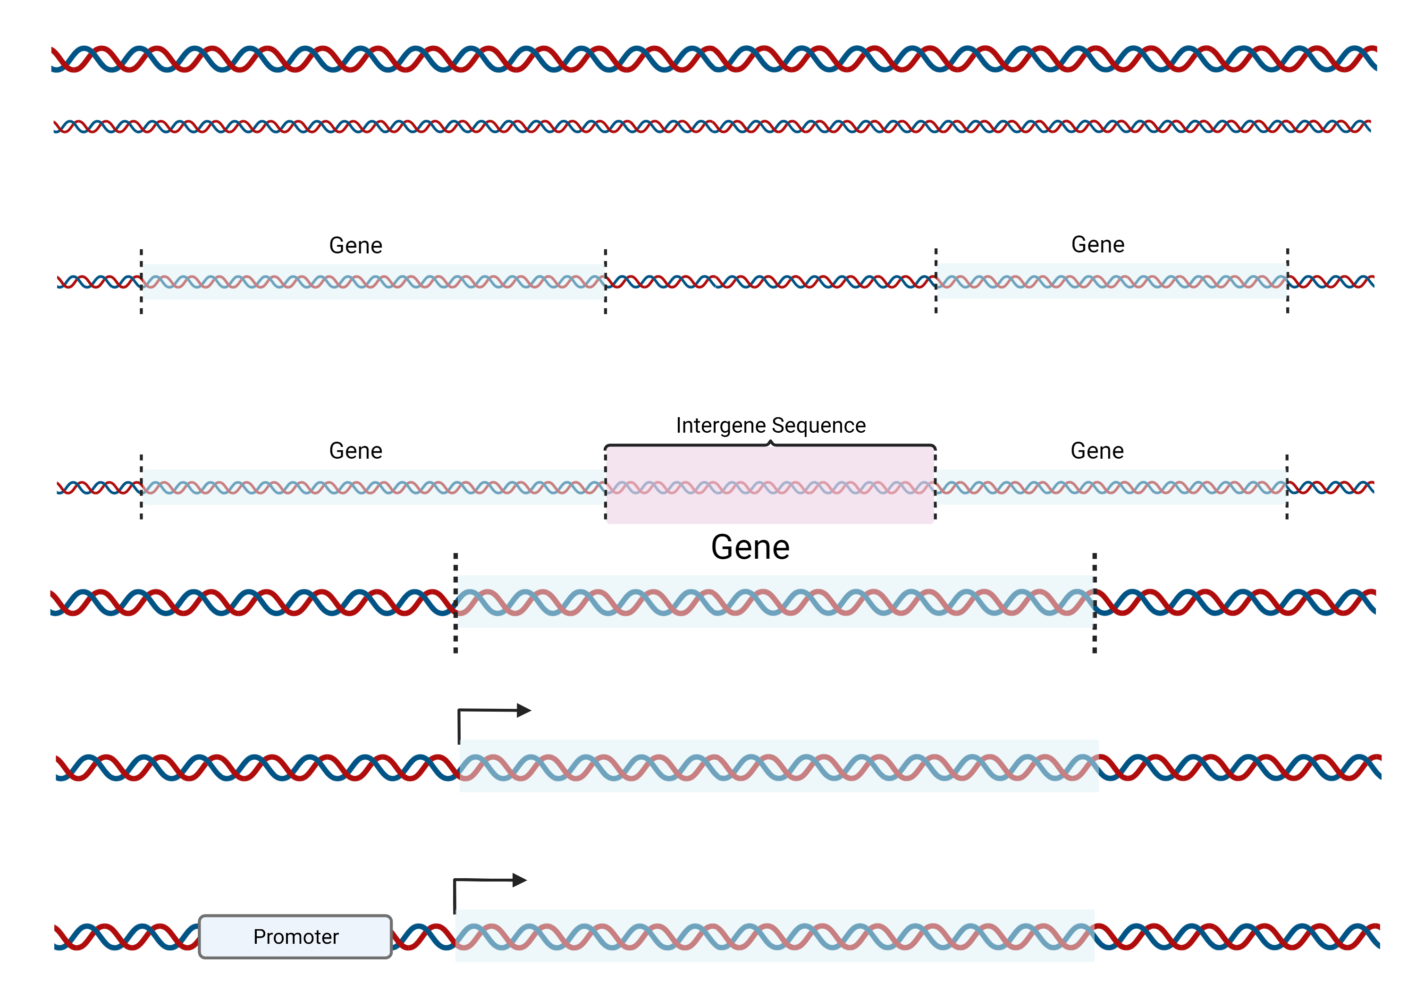
Two Different Phenotypes
Normal Individual/Cells
Mutated Individual/Cells
RNA
R in Action: A Dive into RNASeq Data | Dr Heshmat Borhani | Jan 2025

Slide 13
Two Different Phenotypes
Expression-Level Difference
Gene 1
Gene 2
Gene 3
R in Action: A Dive into RNASeq Data | Dr Heshmat Borhani | Jan 2025

Slide 14
Expression-Level Difference
Gene 1
Gene 2
Gene 3
R in Action: A Dive into RNASeq Data | Dr Heshmat Borhani | Jan 2025

Slide 15
Expression-Level Difference
Gene 1
Gene 2
Gene 3
Gene 1
Gene 2
Gene 3
R in Action: A Dive into RNASeq Data | Dr Heshmat Borhani | Jan 2025

Slide 16
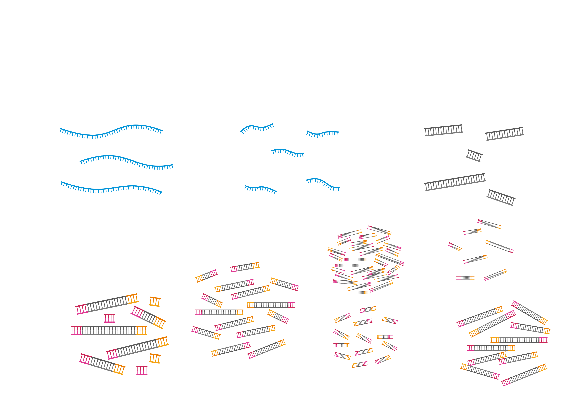
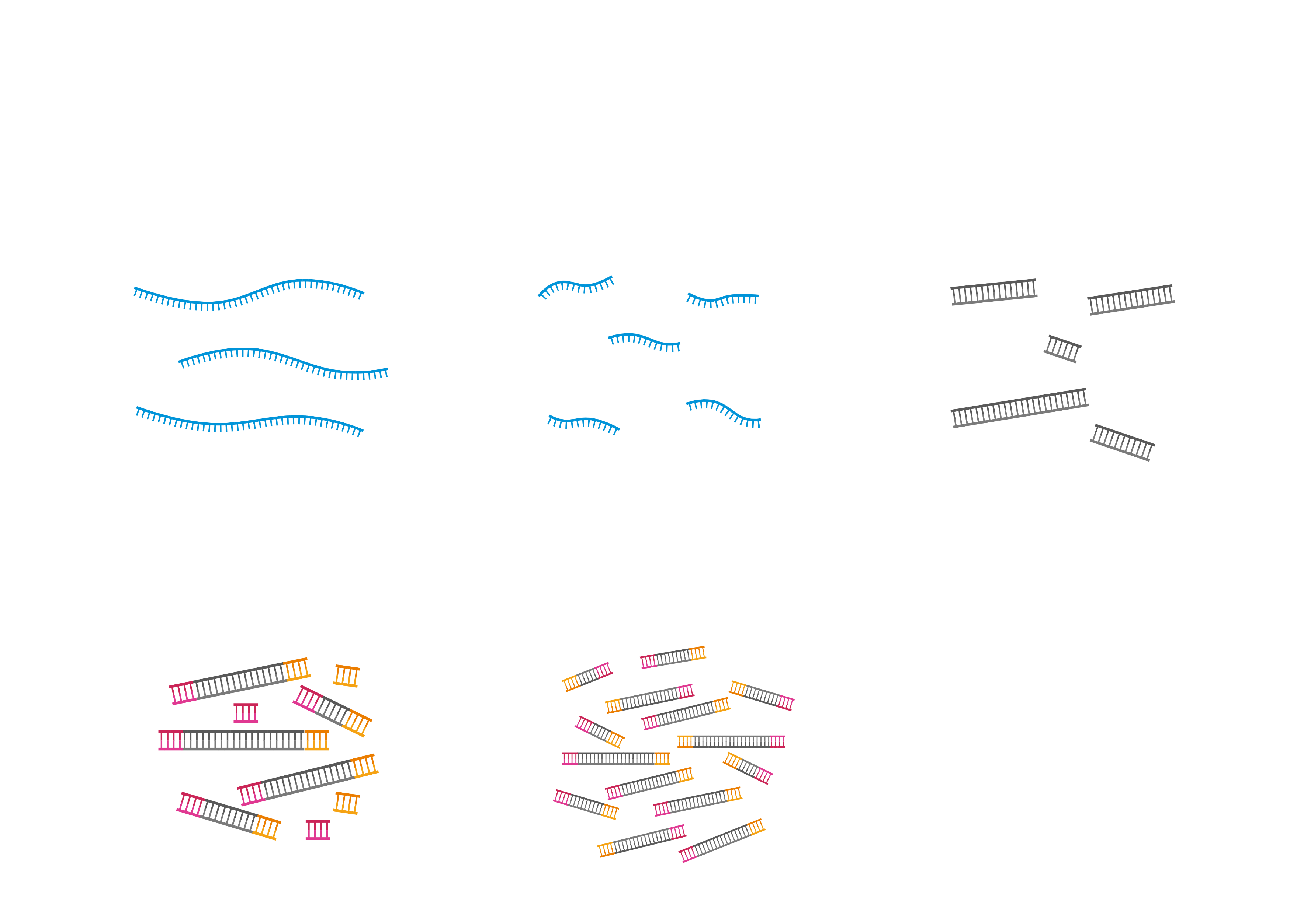
How to count the number of Expressed RNAs for genes?
RNA Isolation from samples
Fragment RNAs into short fragments (200-300 ns)
Convert the fragments into cDNA (dsDNA)
Add sequencing adaptors
Amplify the fragments
QC (library concentration and fragment lengths)
30–50 million reads per sample for experiments like Differential Expression Analysis.
R in Action: A Dive into RNASeq Data | Dr Heshmat Borhani | Jan 2025

Slide 17
Mapping Reads on Reference Sequences
Align and match the reads to the reference genome.
Gene 1
Gene 2
Gene 3
R in Action: A Dive into RNASeq Data | Dr Heshmat Borhani | Jan 2025

Slide 18
Expression-Level Difference
We have all the sequences and positions of ~20000 genes of the human genome so that we can make a matrix of all reads.
Gene | Gene names | Reads
1 | A1BG | 30
2 | A1BG-AS1 | 24
3 | A1CF | 0
4 | A2M | 5
5 | A2M-AS1 | 3564
6 | A2ML1 | 5
… | … | …
20000
Reads
50
120
10
15
300
15
…
R in Action: A Dive into RNASeq Data | Dr Heshmat Borhani | Jan 2025

Slide 19
Is it statistically valid to compare gene expression between just two individuals, one normal and one mutated, and draw conclusions from that comparison?
##/##
Join at: vevox.app
ID: XXX-XXX-XXX
Question slide
Yes, if your plan is to make statisticians cry.
##.##%
No, science isn’t a game of "spot the difference".
##.##%

Slide 20
Is it statistically valid to compare gene expression between just two individuals, one normal and one mutated, and draw conclusions from that comparison?
##/##
Join at: vevox.app
ID: XXX-XXX-XXX
Results slide
Yes, if your plan is to make statisticians cry.
##.##%
No, science isn’t a game of "spot the difference".
##.##%
RESULTS SLIDE

Slide 21
Count Data
Gene names | Sample1 | Sample2 | Sample3 | Sample4 | Sample5 | Sample6
A1BG | 30 | 40 | 100 | 3 | 30 | 4
A1BG-AS1 | 24 | 50 | 150 | 30 | 300 | 50
A1CF | 0 | 10 | 20 | 2 | 20 | 0
A2M | 5 | 6 | 15 | 100 | 250 | 70
A2M-AS1 | 3564 | 4100 | 9800 | 380 | 890 | 400
A2ML1 | 5 | 0 | 10 | 5 | 35 | 5
…..
Metadata
R in Action: A Dive into RNASeq Data | Dr Heshmat Borhani | Jan 2025

Slide 22
Data Analysis
Gene names | Sample1 | Sample2 | Sample3 | Sample4 | Sample5 | Sample6
A1BG | 30 | 40 | 100 | 3 | 30 | 4
A1BG-AS1 | 24 | 50 | 150 | 30 | 300 | 50
A1CF | 0 | 10 | 20 | 2 | 20 | 0
A2M | 5 | 6 | 15 | 100 | 250 | 70
A2M-AS1 | 3564 | 4100 | 9800 | 380 | 890 | 400
A2ML1 | 5 | 0 | 10 | 5 | 35 | 5
…..
R in Action: A Dive into RNASeq Data | Dr Heshmat Borhani | Jan 2025

Slide 23
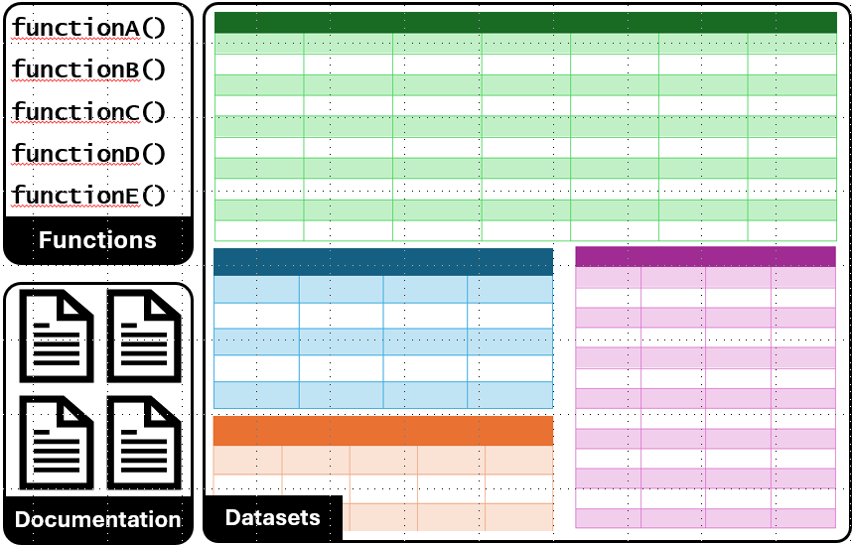

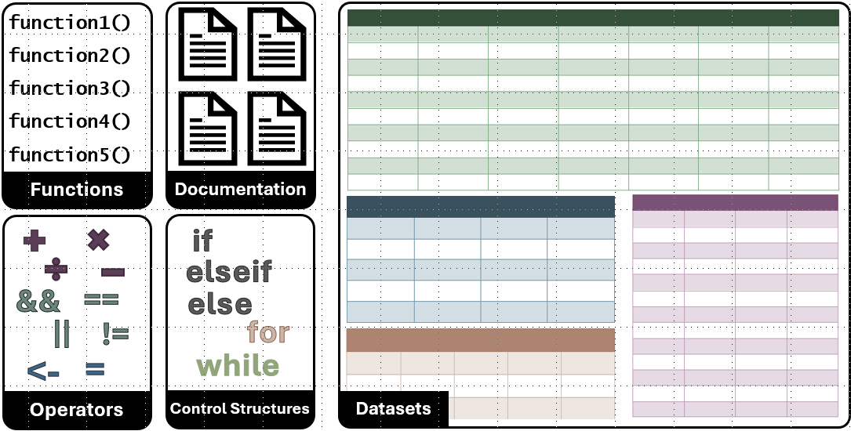
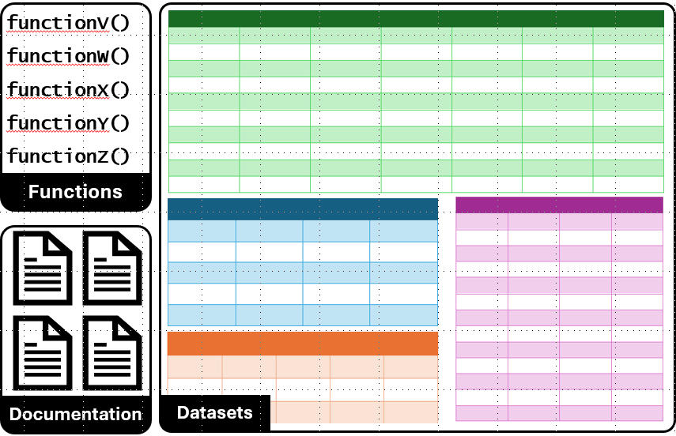

Packages
R Package A
Base R
R Package B
R in Action: A Dive into RNASeq Data | Dr Heshmat Borhani | Jan 2025

Slide 24
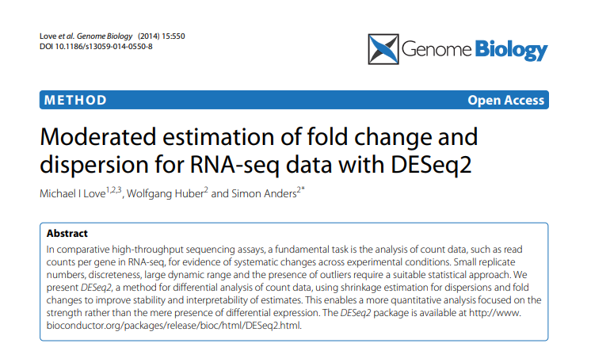
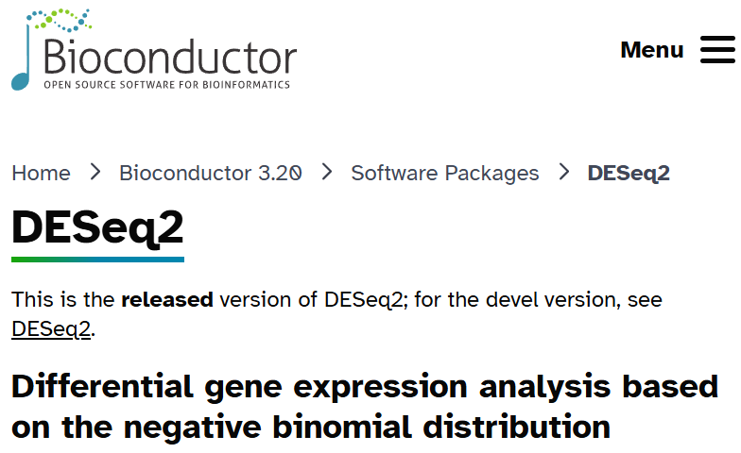
DESeq2 Packages and the Pipeline
https://bioconductor.org/packages/3.20/bioc/html/DESeq2.html
https://genomebiology.biomedcentral.com/articles/10.1186/s13059-014-0550-8
Load counts data and Metadata Files
Prepare Data Structure
Merge Count data and Metadata
Run DESeq2 Analysis
Visualise Results
Interpretation
R in Action: A Dive into RNASeq Data | Dr Heshmat Borhani | Jan 2025

Slide 25
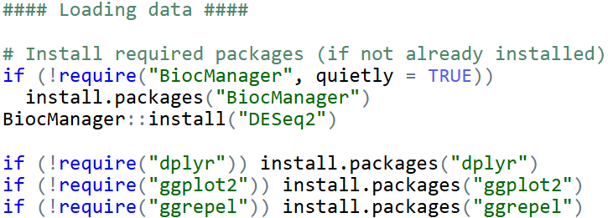
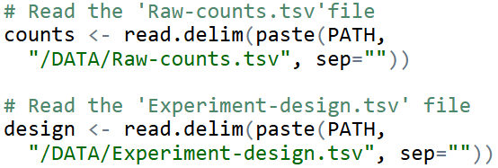
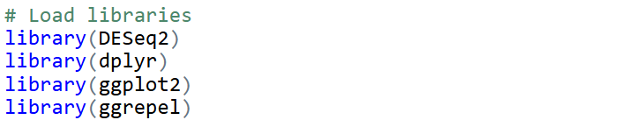
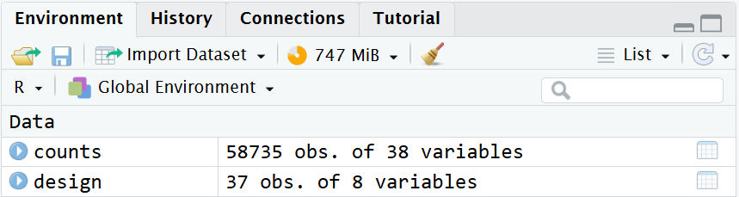
Load counts data and Metadata Files
Prepare Data Structure
Merge Count data and Metadata
Run DESeq2 Analysis
Visualise Results
Interpretation
R in Action: A Dive into RNASeq Data | Dr Heshmat Borhani | Jan 2025

Slide 26
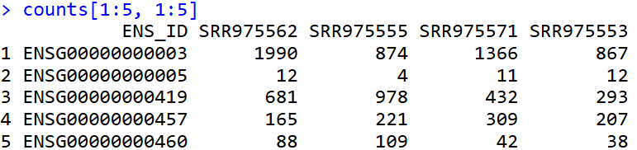
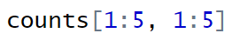
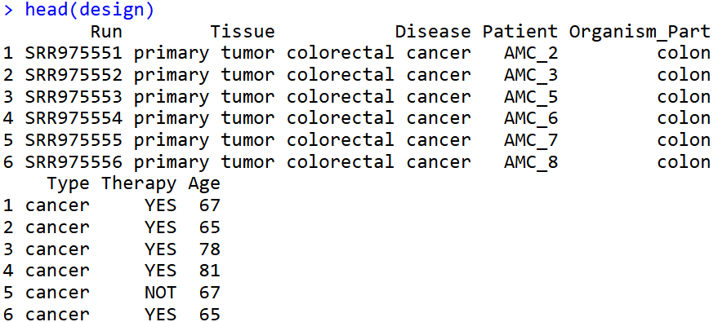
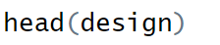
Load counts data and Metadata Files
Prepare Data Structure
Merge Count data and Metadata
Run DESeq2 Analysis
Visualise Results
Interpretation
R in Action: A Dive into RNASeq Data | Dr Heshmat Borhani | Jan 2025

Slide 27
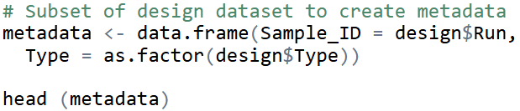
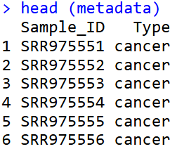
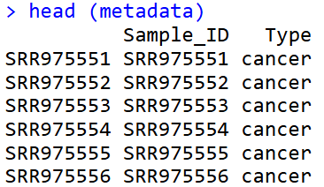
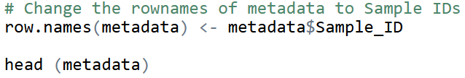
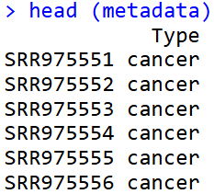
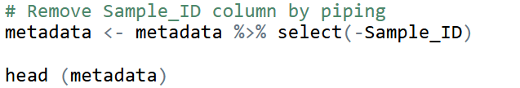
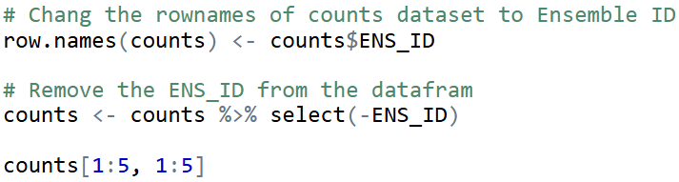
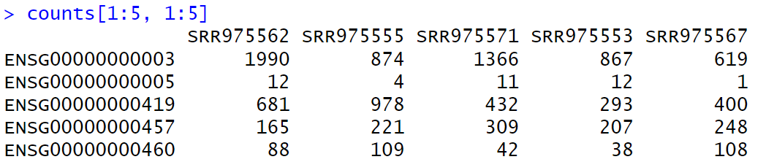
Load counts data and Metadata Files
Prepare Data Structure
Merge Count data and Metadata
Run DESeq2 Analysis
Visualise Results
Interpretation
R in Action: A Dive into RNASeq Data | Dr Heshmat Borhani | Jan 2025

Slide 28
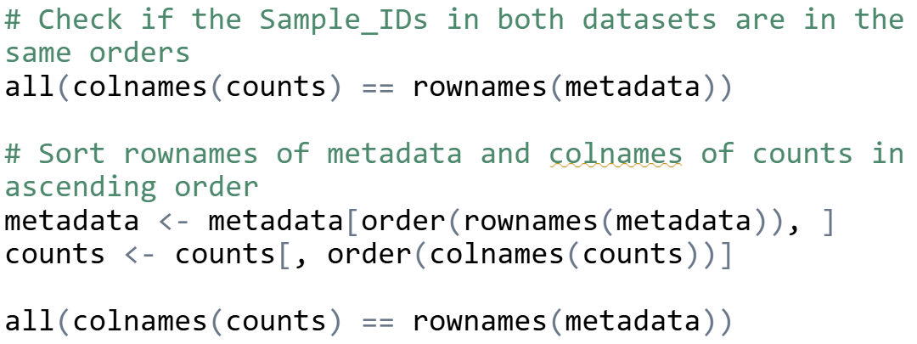
Load counts data and Metadata Files
Prepare Data Structure
Merge Count data and Metadata
Run DESeq2 Analysis
Visualise Results
Interpretation
R in Action: A Dive into RNASeq Data | Dr Heshmat Borhani | Jan 2025

Slide 29



Load counts data and Metadata Files
Prepare Data Structure
Merge Count data and Metadata
Run DESeq2 Analysis
Visualise Results
Interpretation
R in Action: A Dive into RNASeq Data | Dr Heshmat Borhani | Jan 2025

Slide 30






Load counts data and Metadata Files
Prepare Data Structure
Merge Count data and Metadata
Run DESeq2 Analysis
Visualise Results
Interpretation
R in Action: A Dive into RNASeq Data | Dr Heshmat Borhani | Jan 2025

Slide 31
Top UP-Regulated Expressed Genes:
CEMIP, ADAM12, COL11A1, MMP1, INHBA
Top DOWN-Regulated Expressed Genes:
OTOP3, BEST4, SPIB, CA7, ABCG2
Load counts data and Metadata Files
Prepare Data Structure
Merge Count data and Metadata
Run DESeq2 Analysis
Visualise Results
Interpretation
R in Action: A Dive into RNASeq Data | Dr Heshmat Borhani | Jan 2025

Slide 32

Learning Outcomes
1
Understand fundamental concepts about RNASeq data, and why it is important
2
Be able to load, manipulate, and visualise RNASeq data to differentiate between two groups
3
Investigate how gene expression data can be analysed and interpreted
R in Action: A Dive into RNASeq Data | Dr Heshmat Borhani | Jan 2025

Slide 33
In three words, describe what you found most interesting or valuable in this session.
##/##
Join at: vevox.app
ID: XXX-XXX-XXX
Question slide

Slide 34
In three words, describe what you found most interesting or valuable in this session.
##/##
Join at: vevox.app
ID: XXX-XXX-XXX
Results slide
RESULTS SLIDE

Slide 35
Thank You!
Any Question?
Heshmat Borhani
BSc, MSc, PhD, FHEA, FIBMS
Heshmat.Borhani@nottingham.ac.uk
Office hours; Mondays 12:00-13:00
Life Science Building, B61

